Slide 1
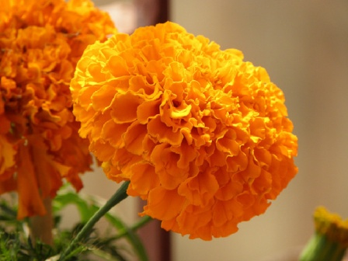
welcome

Slide 2
Teacher’ identity
Name:Md Rokonujjaman assistant teacher,Sitarampur govt.primary school

Slide 3
Lesson identity
sub: English
Lesson:Alphabet
Class: Two
Time:30 minutes

Slide 4
Learning outcomes: At the end of the lesson students will be able to
1.1.2 Say simple words and phrases
1.2.1 recognize and read the alphabet both small and capital letters

Slide 5
Lesson declaration
Lesson 4-6
Chapter 6
Page 13

Slide 6
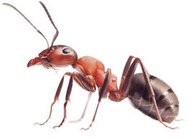
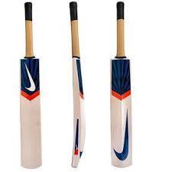
Match the letter with the object
A
B

Slide 7
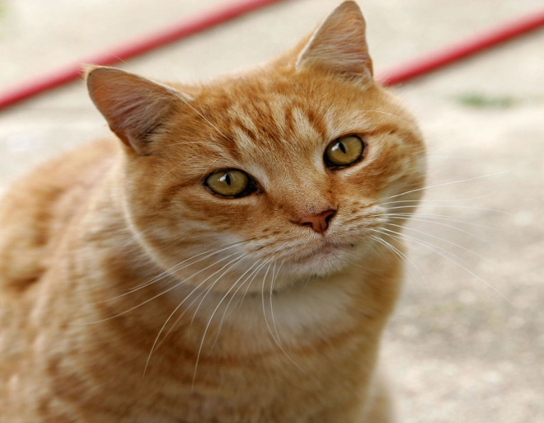
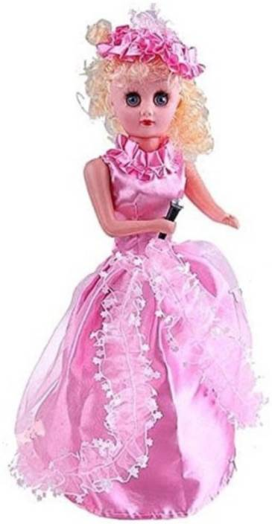
C
D

Slide 8
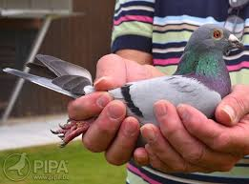
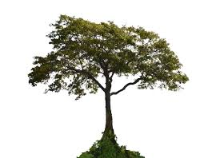
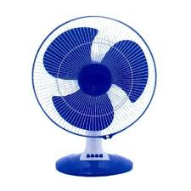
f
p
t

Slide 9
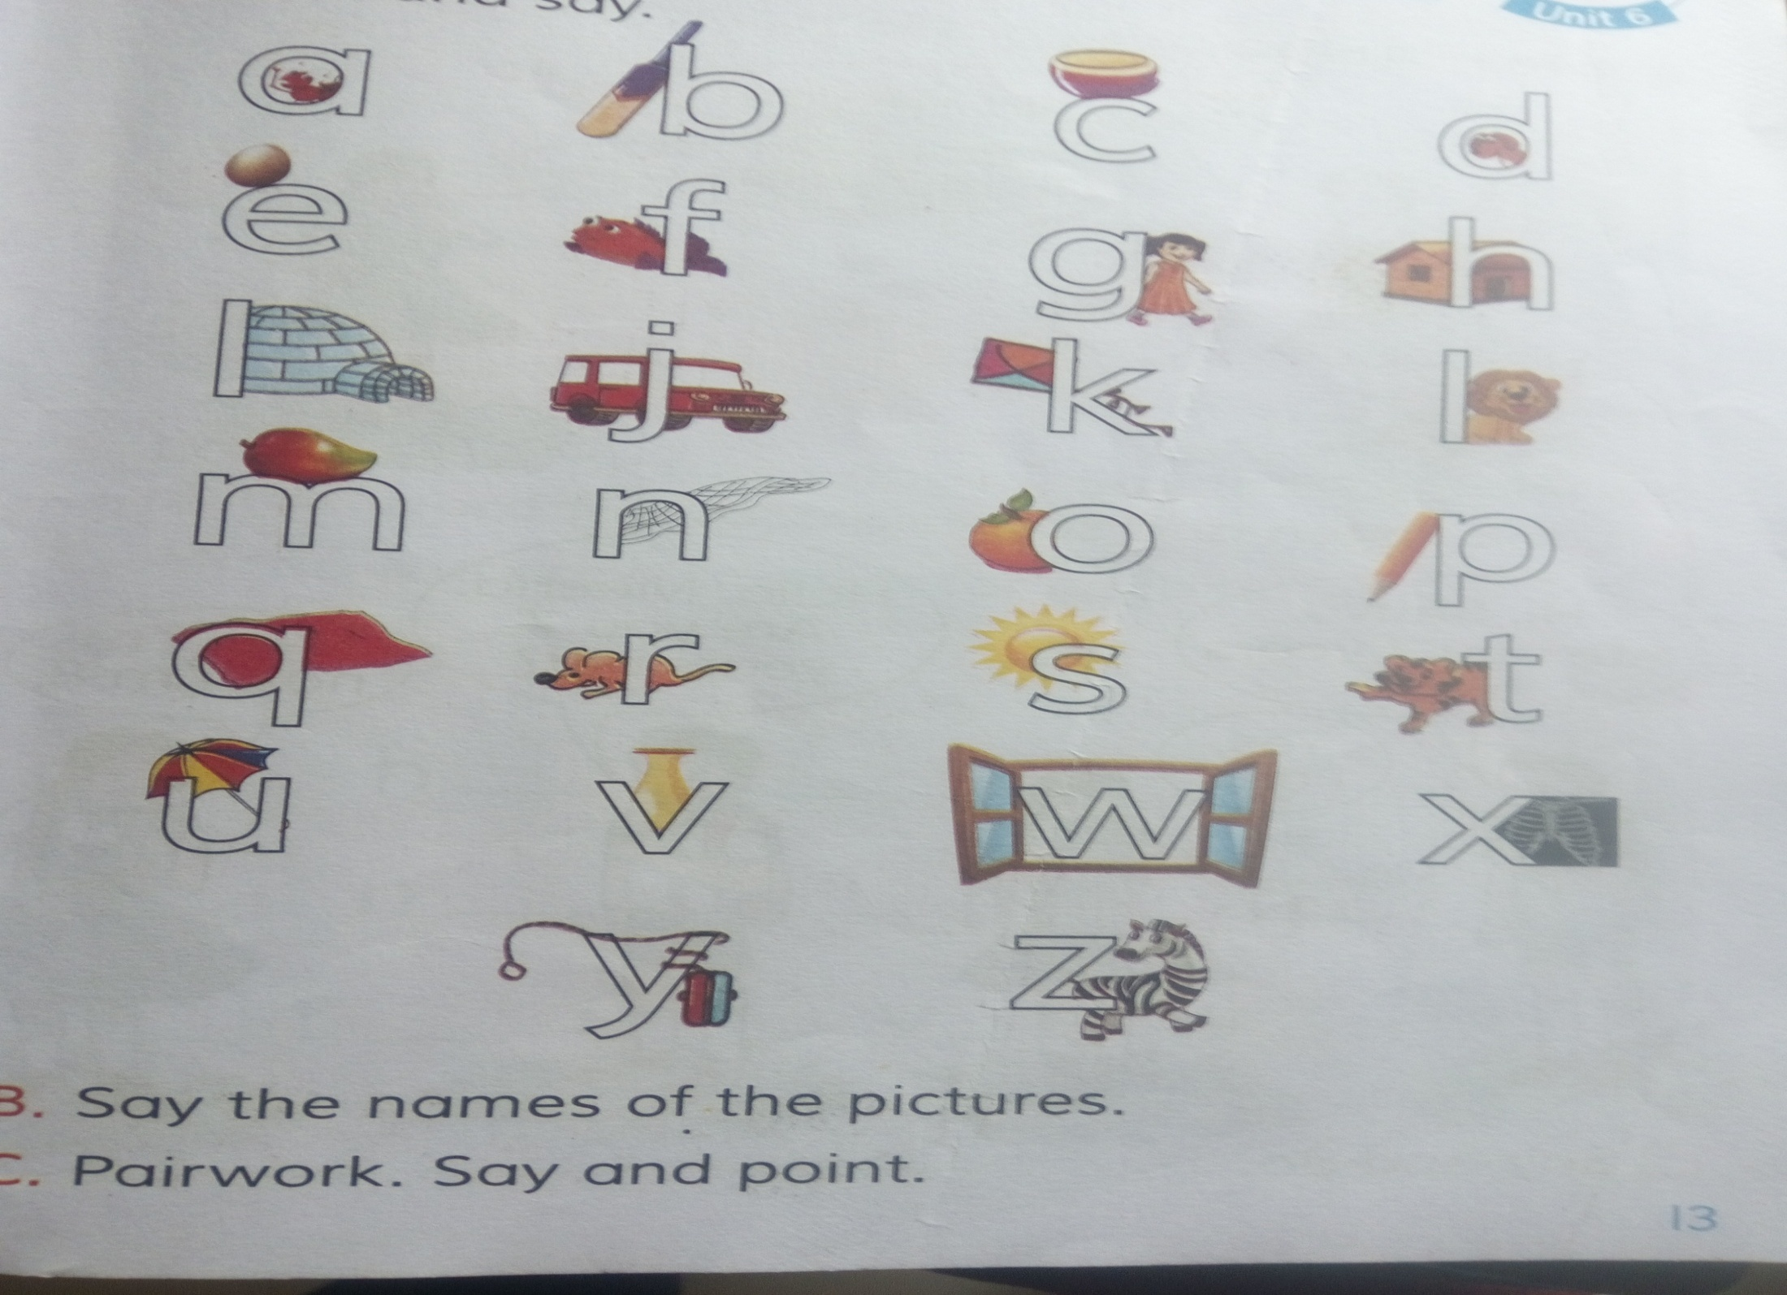

Slide 10
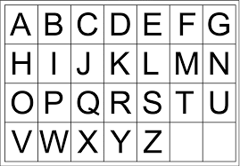
Capital letters

Slide 11
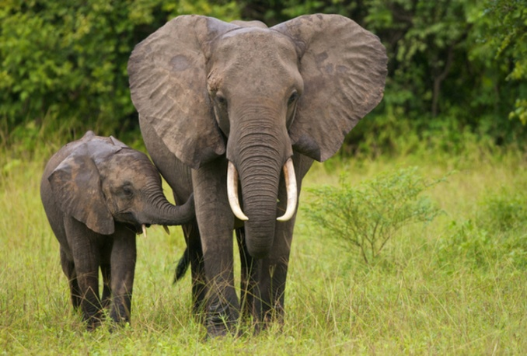

Match the letters
C
E

Slide 12

Group work
1.Identify the small letters;
.
A, h ,Q, f, g, t, E, j. l, u, Y, o, b, m, e, h,B,a
2.Find out the capital letters
D,y,T, L ,R,e,Q,n,M,J ,Y ,E,q,G,B,i

Slide 13
Fill in the blanks
1
.
A
B
C
F
2.
E
G
l
m
n
o
p
3.

Slide 14
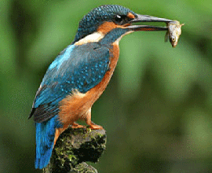
Thanks to all

